Slide 1
Hardware Trojan Horse in DNN for misclassification
Boris Bukchin

Slide 2
AGENDA
Introduction
Experiment setup
Attack framework against NN
Countermeasures
Summary
Notes:
In my work I implemented a suggested attack on CNN,
Then tried to find countermeasures.

Slide 3
INTRODUCTION
Recently, Deep Learning (DL), especially Convolutional Neural Network (CNN), develops rapidly and is applied to many tasks, some of which are extremely safety-critical:
intelligent surveillance
autonomous driving

Slide 4
INTRODUCTION
Due to the latency and privacy problem of cloud computing, embedded accelerators are popular in these safety-critical areas.
Usually, the accelerator or neural network model are provided by third-party companies.
However, the robustness of the embedded DL system might be harmed by inserting hardware/software Trojans into the accelerator and the neural network model.

Slide 5
Hardware / software Trojan
 | Hardware | Software
Flexibility | Inflexible attack | More flexibility
Availability | Easy | Harder - Usually requires image tampering
Notes:
Inflexible: full breakdown
Hard: Data poisoning with glasses – can be tested out, Hidden patterns – hard to implement (even harder with real cameras)

Slide 6
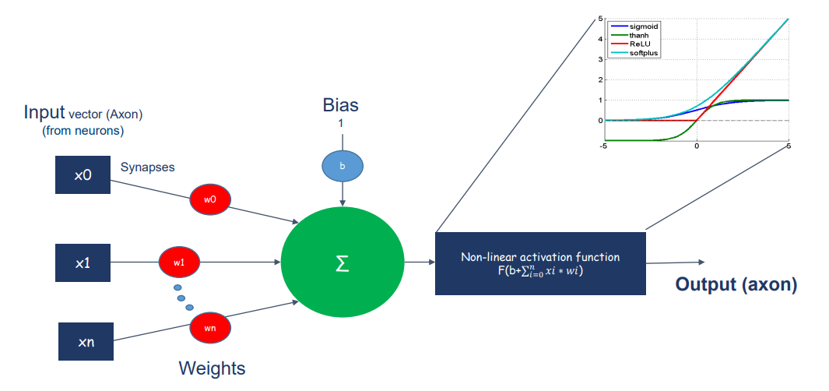
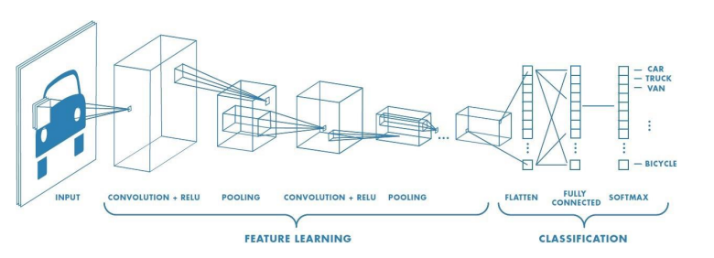
background - CNN
Convolutional Neural Network for image classification.

Slide 7
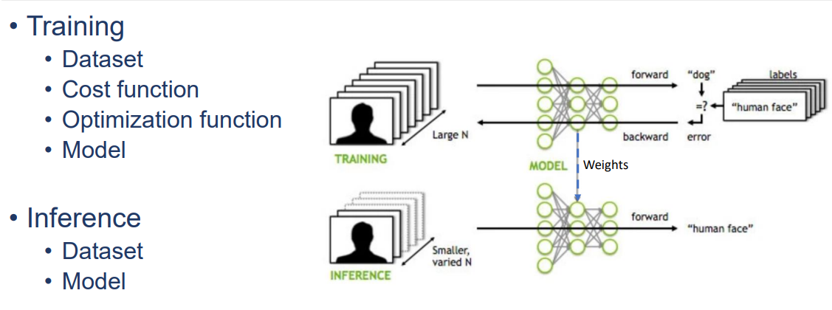
background - Training / interface

Slide 8
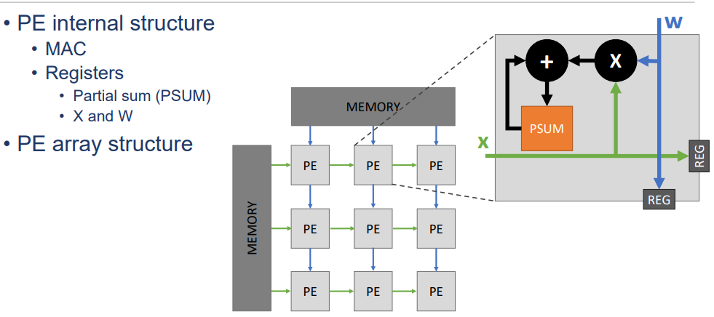
Background -CNN Hardware accelerators

Slide 9
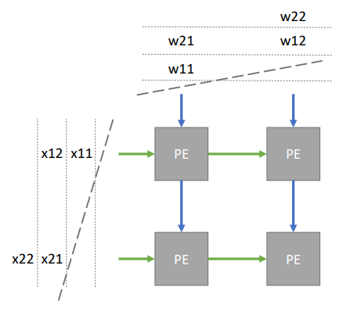

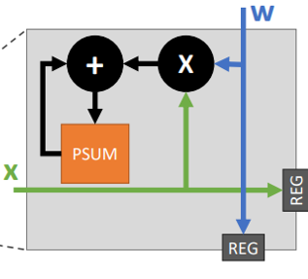
Background -CNN Hardware accelerators

Slide 10
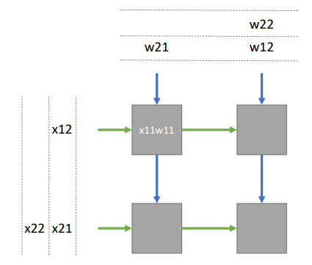
Background -CNN Hardware accelerators

Slide 11
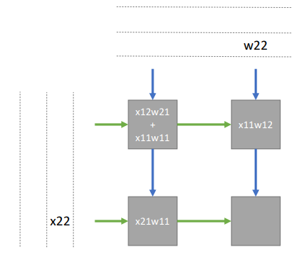
Background -CNN Hardware accelerators

Slide 12
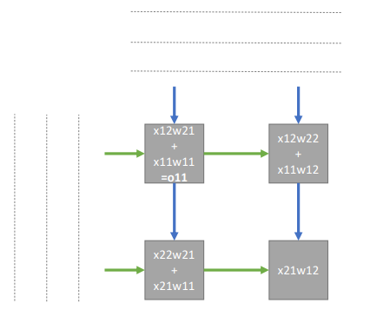
Background -CNN Hardware accelerators

Slide 13
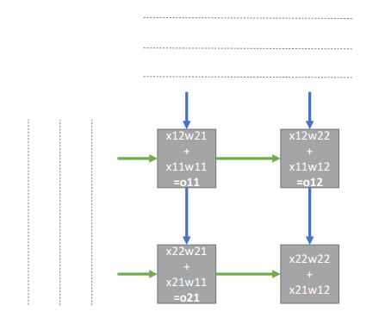
Background -CNN Hardware accelerators

Slide 14
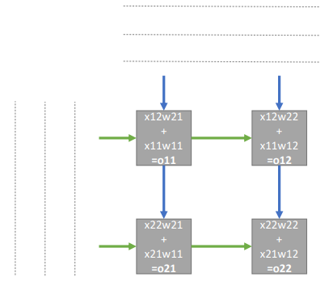
Background -CNN Hardware accelerators

Slide 15
Experiment Setup

Slide 16
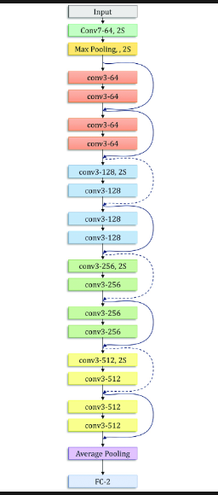
RESNET18
18 Layers of convolution with skip connections, fully connected layer at the end.

Slide 17
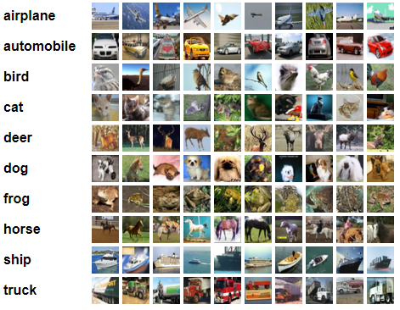
CIFAR10
The CIFAR-10 dataset contains 60,000 32x32 color images in 10 different classes.

Slide 18
Pytorch
PyTorch is a machine learning framework based on the Torch library, used for applications such as computer vision and natural language processing.
It is free and open-source software with an easy Python interface.

Slide 19
Attack framework against NN
Hardware and Software Collaborative Attack

Slide 20
Attack model
The attackers are the providers of the accelerators and the toolchains.
Hardware Trojan circuits.
Software neural network with Trojan weights.
Input images need not to be manipulated.
On trigger the NN gives specific wrong answers as attacker expects.
On normal operation mode Trojan is hard to detect.
Special algorithm to insert Trojan without influencing the original CNN.

Slide 21
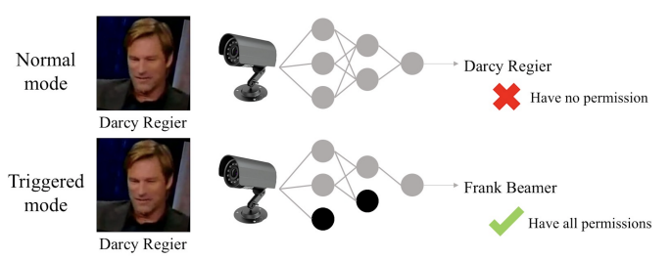
Motivation
Label-exchanging attack: We exchange the labels of two classes when training the part weights, and two specific classes would be misclassified as the other.

Slide 22
Trigger
Combinational/Sequential logic.
Sensors.
One bit wire connected to a pin.
Special images.
Normal images in specific sequence.

Slide 23
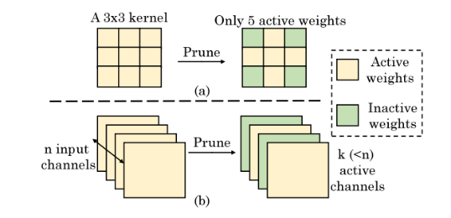
Training
We prune the original neural network according to a specific subnet design.
Then we train the sparse neural network with specific training purpose to achieve the attack effect, all inactive weights remain zero.
We keep the active weights unchanged and train the inactive weights only.

Slide 24
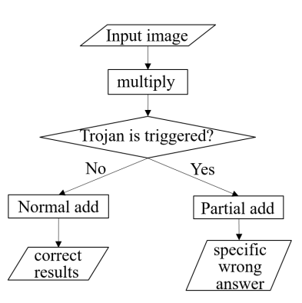
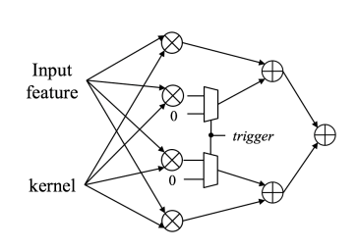
inference
The Trojans are inserted in add part of the processing unit. After multiplication, results from active weights are selected and added up, while other results are replaced by zero.

Slide 25
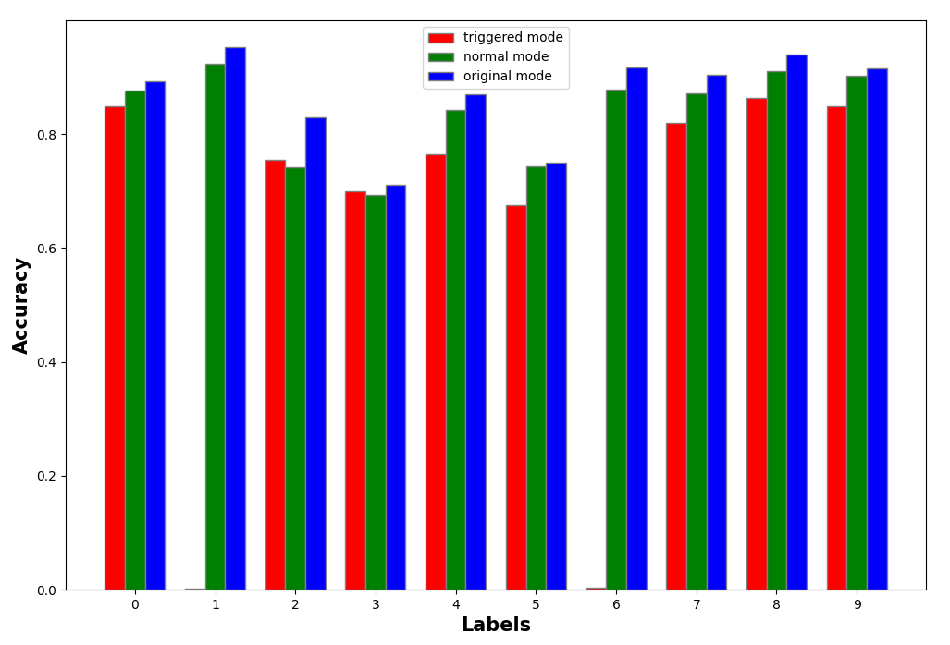
Attack Results
The triggered NN is trained to exchange the labels of automobile (1) and frog (6).
The accuracy of normal mode is almost the same as original performance.
High attack success rate.
 | Original Accuracy | Normal Accuracy | Attack Success Rate
Pixel parallelism | 83.8% | 86.7% | 90%
Triggered Mode | Predict | 1 | 6
Label | 1 | 0.4% | 93.6%
 | 6 | 86.6% | 0.1%

Slide 26
Countermeasures

Slide 27
Quantization
DNNs exhibit resiliency to quantization in their intermediate results, this is usually used to speed up DNNs and reduce power consumption.
The idea is to check resiliency of the DNN with the trojan – in both triggered and normal mode, in comparison with the original DNN.
Since the trojan NN is not optimal for original dataset we expect to see higher sensitivity to quantization in the trojan NN from the original NN.
If adversarial shows higher sensitivity than original, fine-tuning techniques like quantization can be used as a defense technique as well as efficiency improvements.

Slide 28
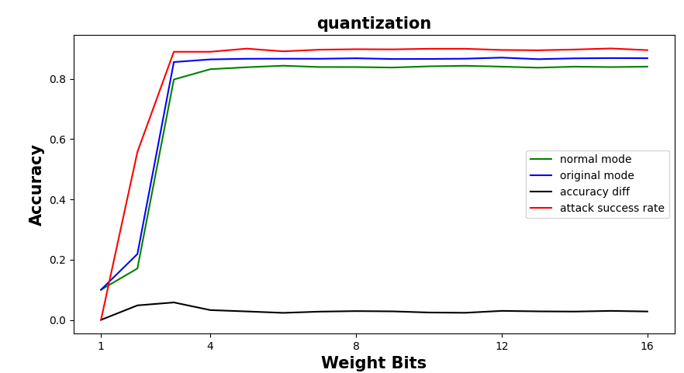
Weight Quantization-results
Didn’t observe significant sensitivity in NN with trojan.
Attack success rate is high with only 3 weight bits.
Accuracy difference stays low.
The result can be explained

Slide 29
Pruning
Common optimization of DNNs for speed and power consumption is pruning weights.
The idea is to prune the weights of attacker’s network and compare the sensitivity in comparison to original network.

Slide 30
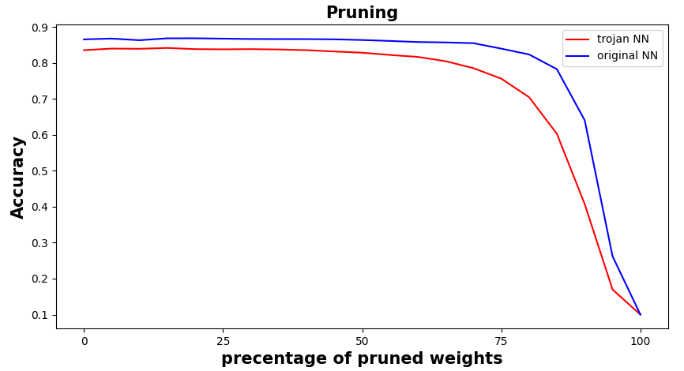
Pruning-Results

Slide 31
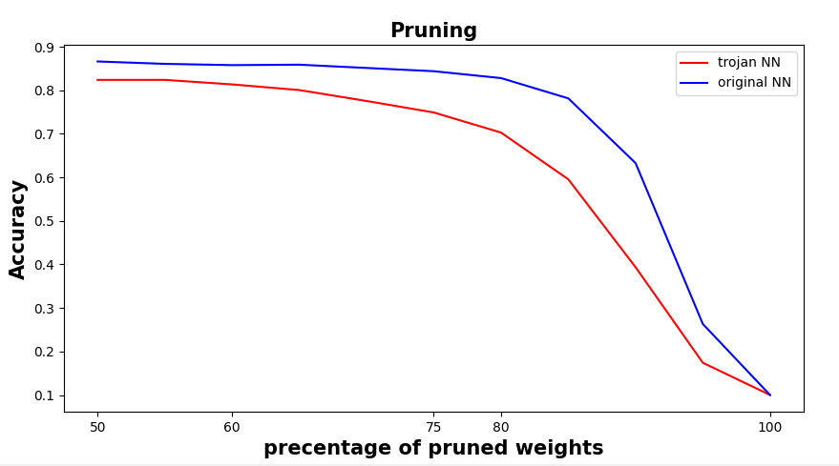
Pruning + quantization-Results
4-bit quantization

Slide 32
Hardware trojan detection
Side Channel Signal Analysis
In proposed attack trigger is added and may affect power.
Trigger logic may affect timing.
Reverse Engineering
Full Activation of Trojan

Slide 33
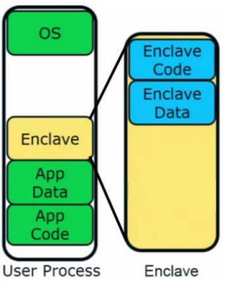
Secure enclave
A secure enclave is a hardware-isolated, trusted execution environment that can run kernels in isolation from other processes or code blocks.
Secure enclave protects the code and data from being tampered with by the attackers during the execution.
Remote attestation enables to prove to a remote party that the enclave and the hardware are “legit”.
Secure enclave can prevent the special training algorithm used by described attack since code and data are encrypted and verified.

Slide 34
summary

Slide 35
Summary

Slide 36
THANK YOU
Boris Bukchin
buboris@campus.technion.ac.il

